Slide 1
Project 4:
Predict West Nile Virus
Geh Si Rong, Lee Meng Chin, Teo Zhan Rui, Wee Zi Jian

Slide 2
TABLE OF CONTENTS
01
02
03
04
05
06
Problem Statement
Pre-Processing
Exploratory Data Analysis
Modelling
Cost Benefit Analysis
Conclusion / Recommendations

Slide 3
Problem Statement
The West Nile virus (WNV) is a mosquito-borne illness that can cause severe neurological disease and death in humans.
Since 2004, the Chicago Department of Public Health has increased surveillance and control efforts in a bid to prevent transmission of this virus.
Given weather, location, testing, and spraying data, our goal is to predict whether the WNV is present in a given location.
Based on our predictions, we will devise a cost effective strategy to deploy pesticides in WNV-hotspots.

Slide 4
Pre-Processing: Train / Test
Train: 10,506 rows, 12 columns (2007, 2009, 2011, 2013)
Test: 116,293 rows, 11 columns (2008, 2010, 2012, 2014)
Relevant columns:
Date
Species
Longitude
Latitude
WNV present
Set date as index
Assign nearest weather station to each trap
Group by mosquito species
Convert species to categorical features

Slide 5
Pre-Processing: Weather
2,944 rows, 22 columns
Daily data from May-October 2007-2014
Impute missing values (‘M’) and trace values (‘T’) with 0 or mean
Convert weather conditions (CodeSum) to categorical variables
Compute 14 day rolling average/sum of various weather data
Compute lagged (3, 5, 7, 10 days) versions of rolling weather data
Assign weather data to train/test data based on nearest weather station

Slide 6
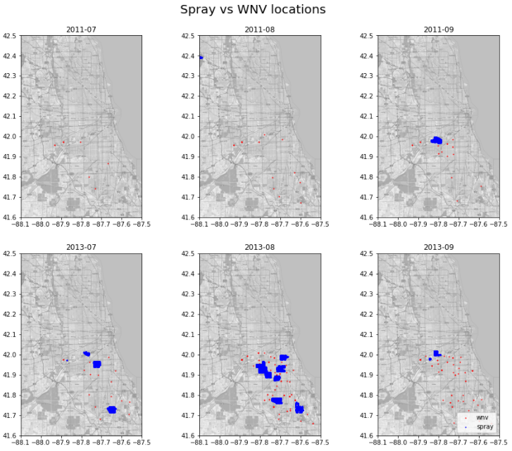
Pre-Processing: Spray
14,835 rows, 4 columns
2011 and 2013 spray locations and dates
Based on plots of sprayed locations vs WNV presence, spraying does not appear to reduce WNV presence in subsequent months
Notes:
Based on plots of sprayed locations vs WNV presence, spraying does not appear to reduce WNV presence in subsequent months

Slide 7
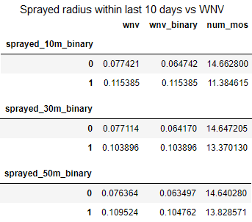
Pre-Processing: Spray
2011 and 2013 train data locations were checked if they had been sprayed within a certain radius within the past 10 days
Spraying within 10m, 30m and 50m of a location within the last 10 days has marginal effect on the number of mosquitoes caught or the presence of WNV
Since spray data for 2008, 2010, 2012 and 2014 is unavailable as well, spray data will not be used in modelling

Slide 8
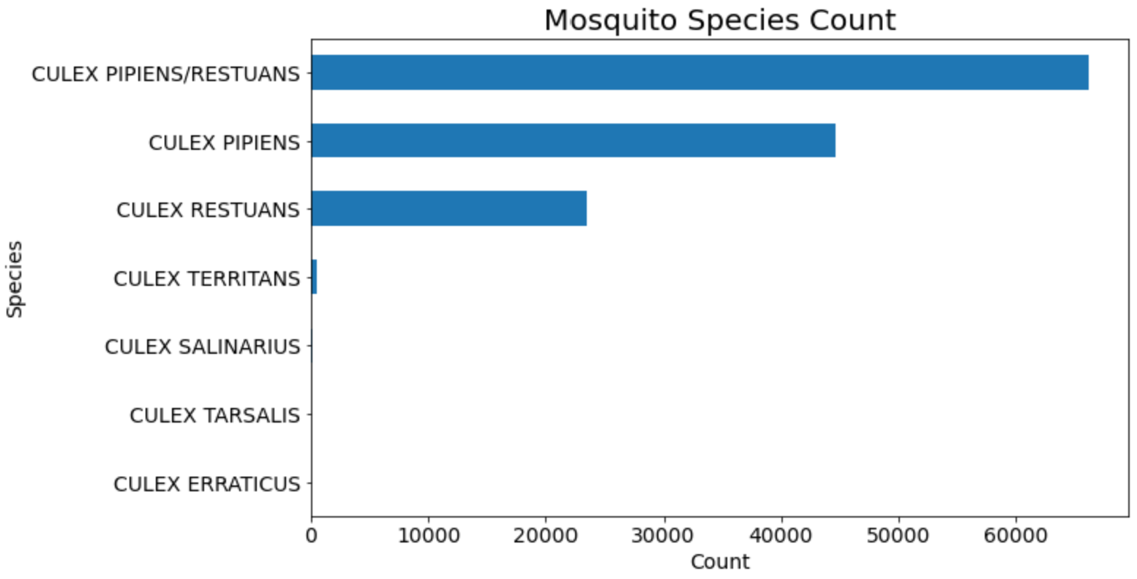
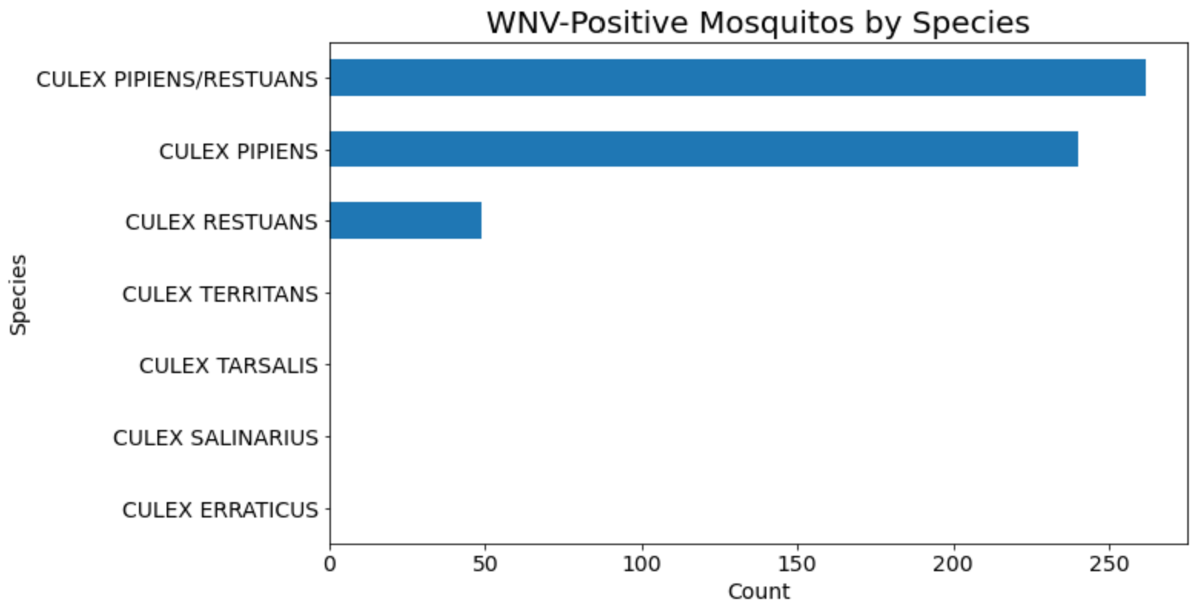
EDA: Mosquito Counts
3/7 species found with WNV
Most frequently caught species
Species expected to be an important feature in predicting WNV
Notes:
Distributions of total mosquito counts and WNV-positive mosquito counts differ, we should expect species to be an important feature in predicting WNV

Slide 9
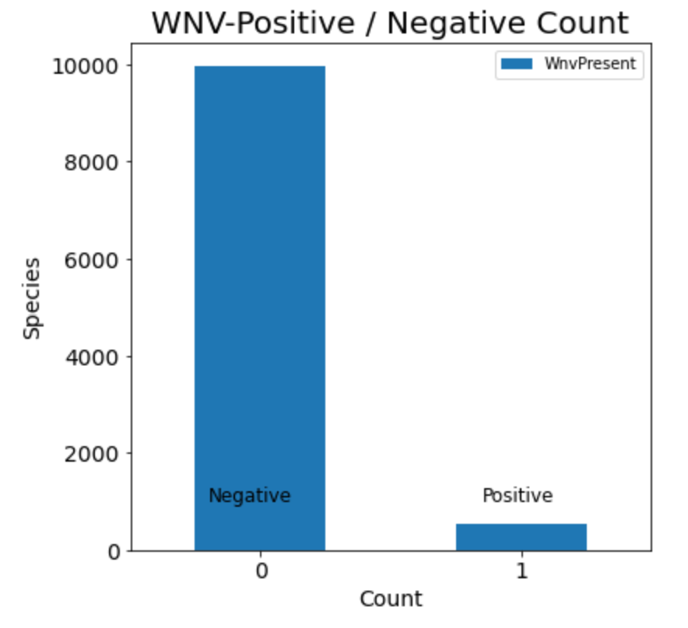
EDA: WNV Positive/ Negative Counts
WNV-negative vs WNV-positive
9,955 551
Imbalanced classes
Minority class was resampled using SMOTE

Slide 10
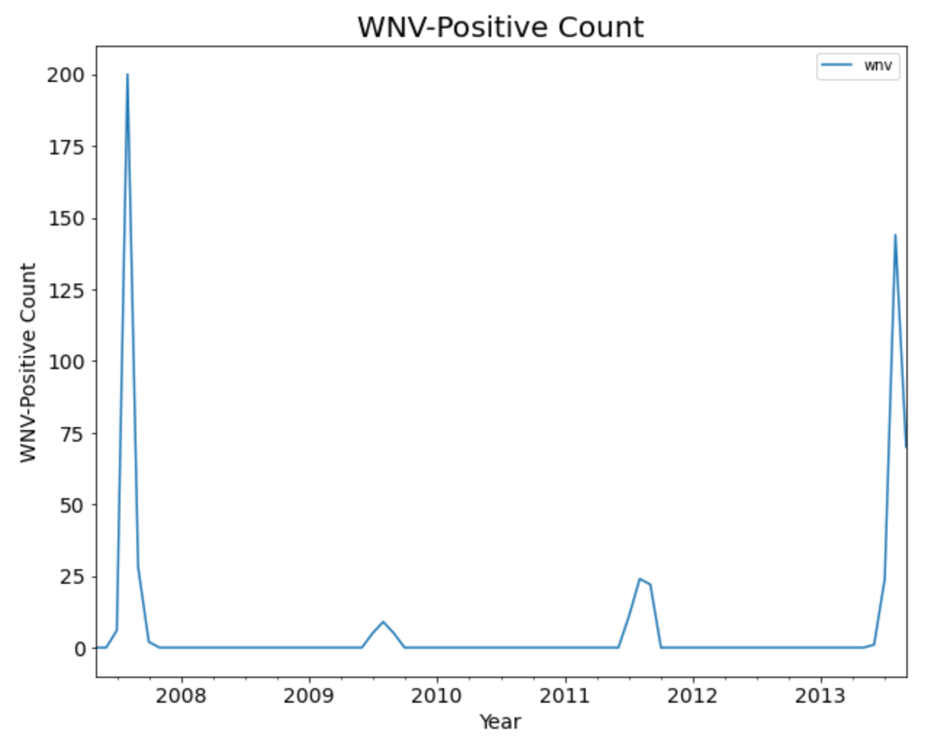
EDA: WNV-Positive by Date
WNV-Season: Jul to Sep
Huge spikes in 2007 and 2013
Notes:
WNV-positive mosquitoes were most frequently caught in August and September each year
2007 and 2013 had the most number of WNV-positive mosquitoes caught

Slide 11
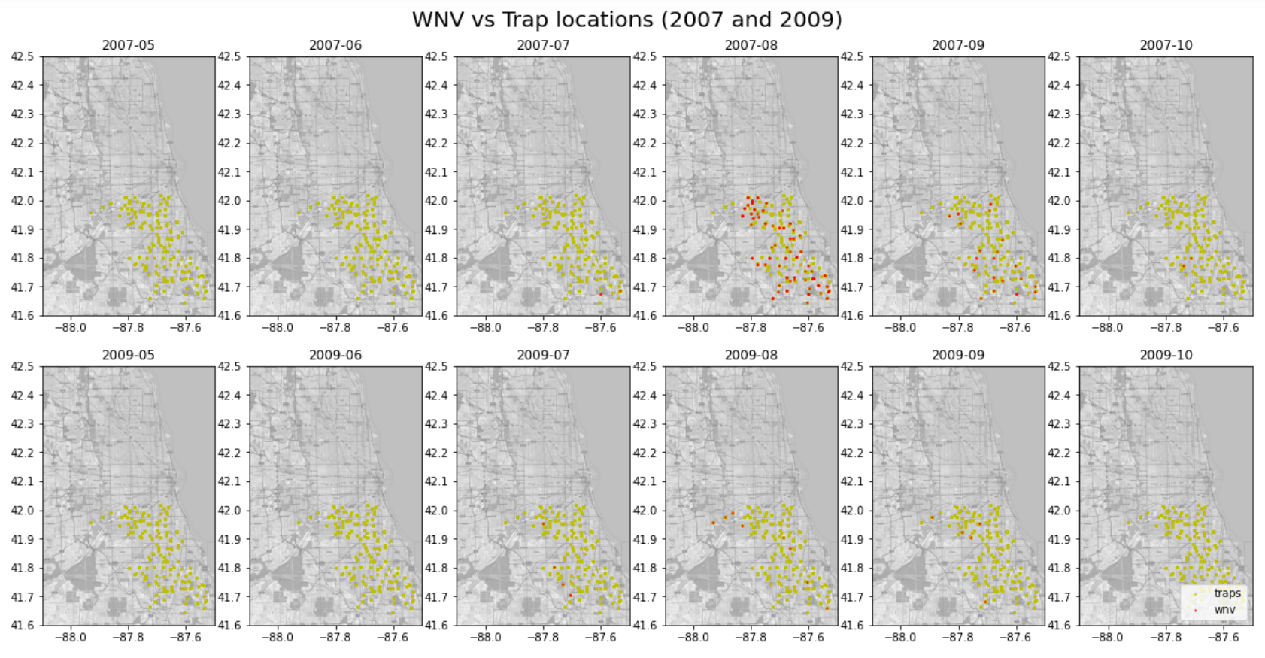
EDA: WNV-Positive by Location

Slide 12
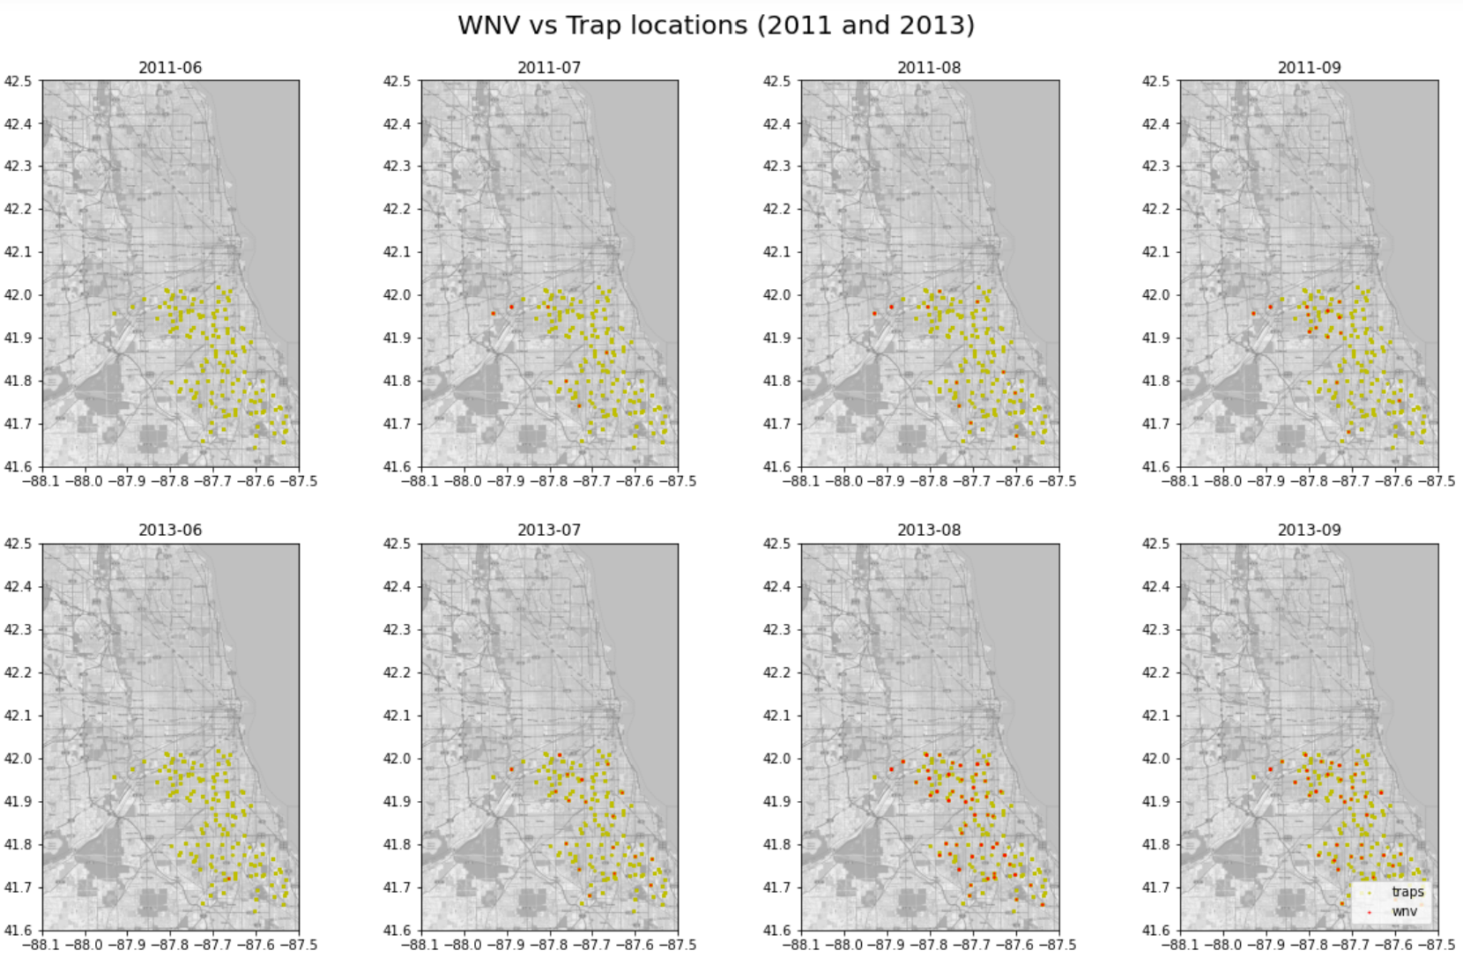
EDA: WNV-Positive by Location

Slide 13
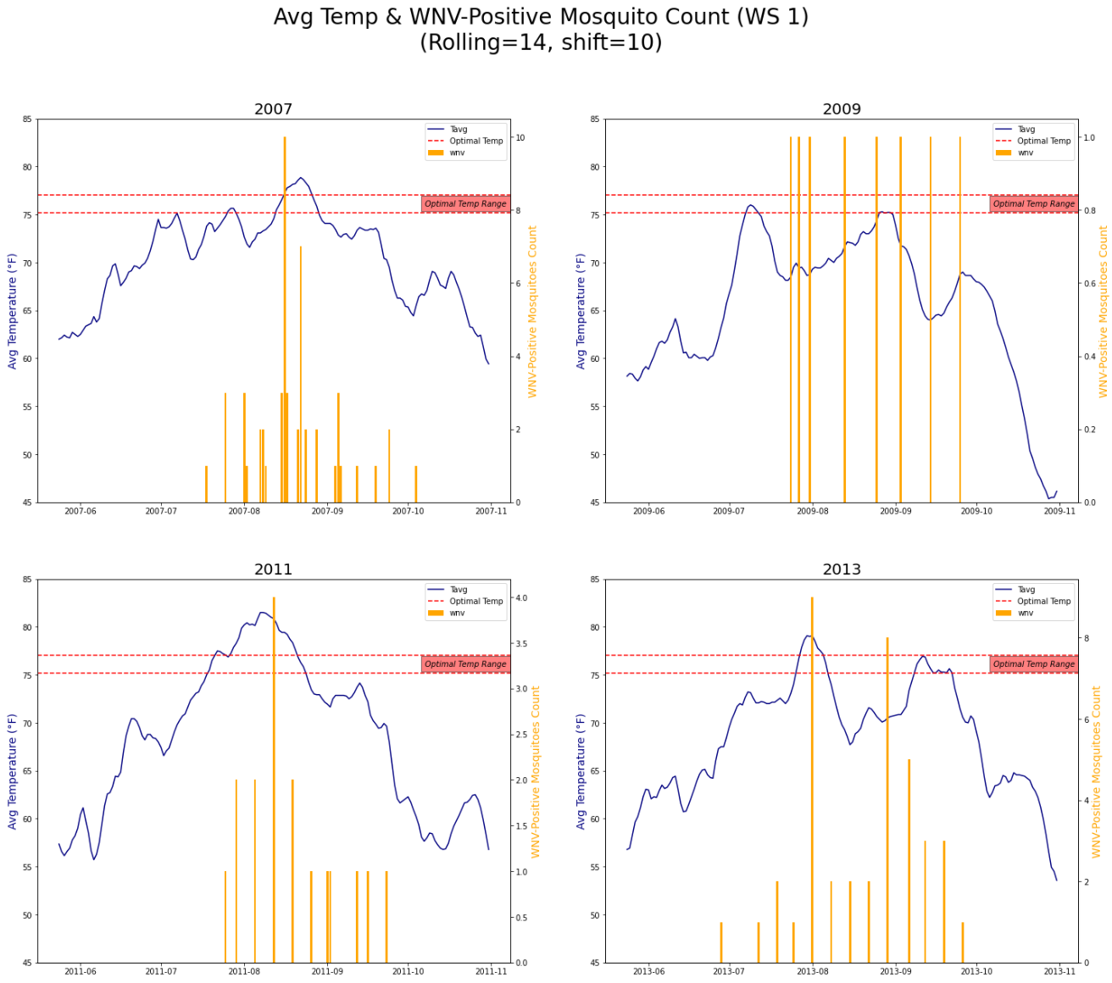
EDA: Temperature
Immediate & delayed impacts observed
Impact of Temperature
↑ Reproduction
↑ Biting
↑ Virus replication
Optimal temperature: 75.2 - 77°F

Slide 14
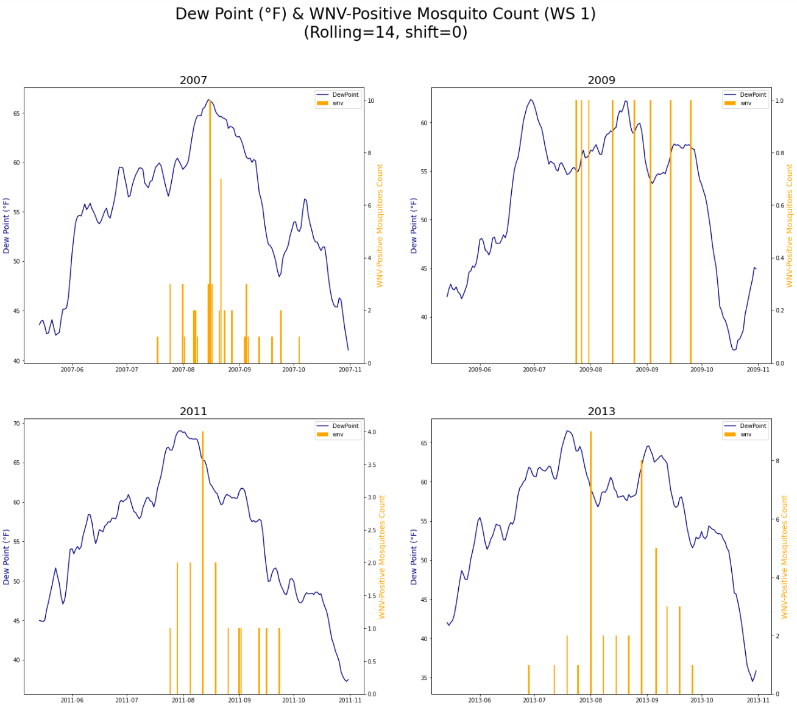
EDA: Dew Point
Peak between July and September
High dew points linked to higher WNV counts

Slide 15
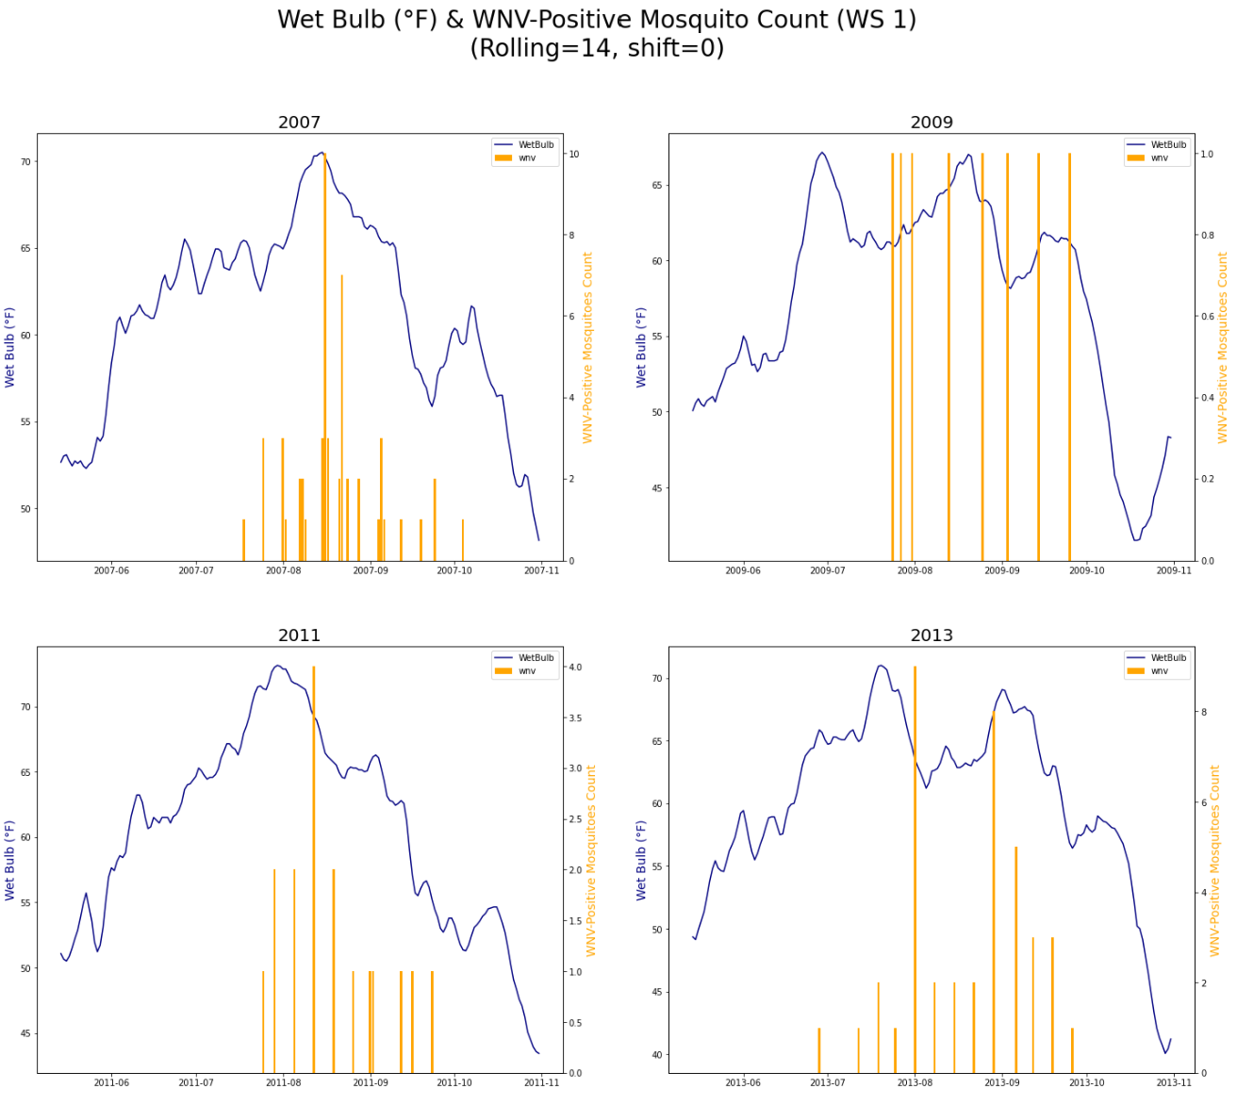
EDA: Wet Bulb
Peak between July and September
Wet bulb - humidity relationship
High humidity offsets higher temperatures
Notes:
Higher wet bulb temperatures are associated with higher levels of humidity, which offsets the higher temperatures, and thus results in higher WNV counts

Slide 16
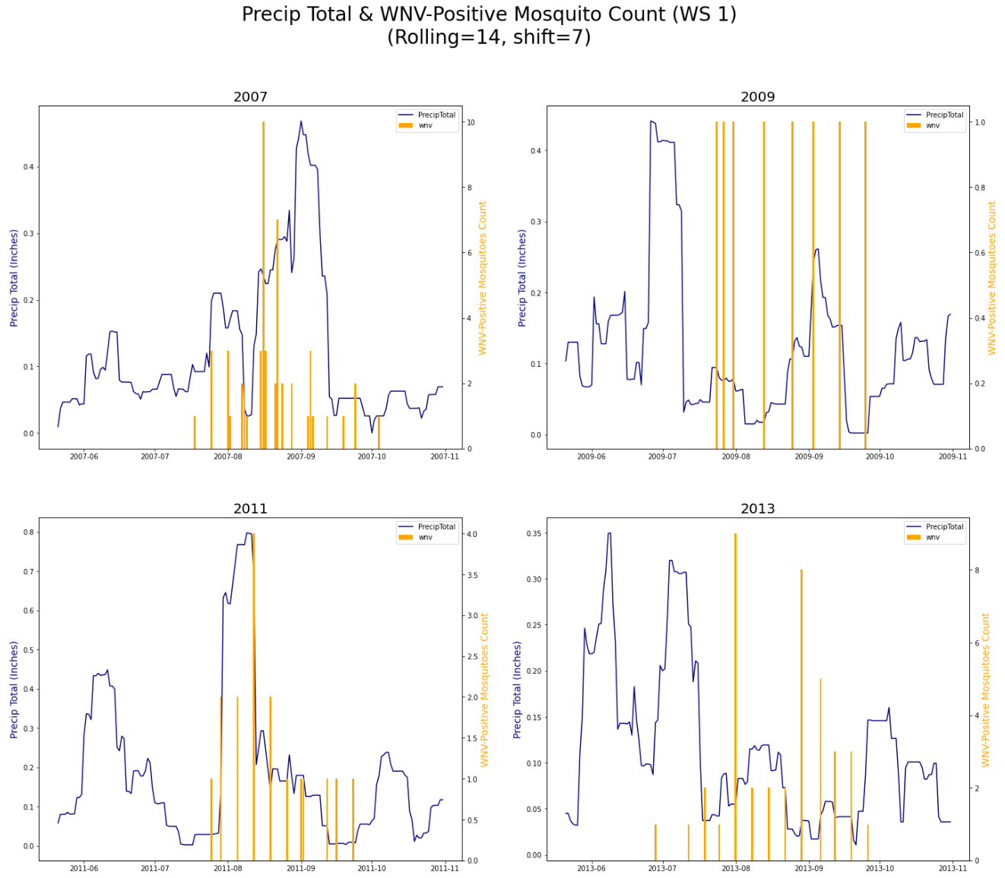
EDA: Precipitation
Precipitation encourages breeding
Spike in WNV-positive counts after heavy precipitation (2009, 2011, 2013)

Slide 17
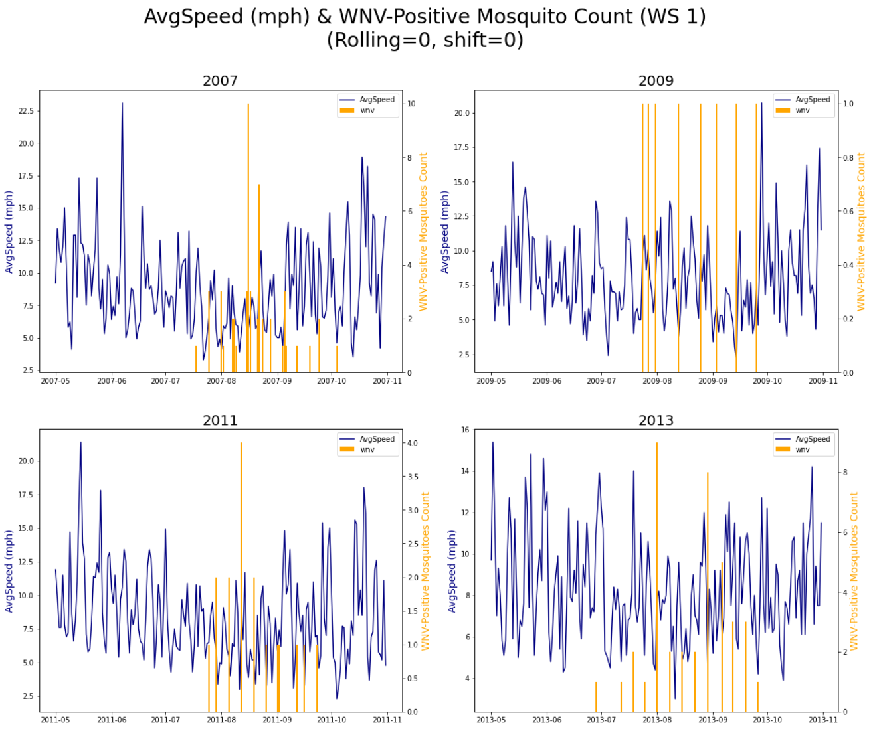
EDA: Wind
Lower wind speeds show higher WNV numbers
Mosquitoes caught by traps during lower wind speeds

Slide 18
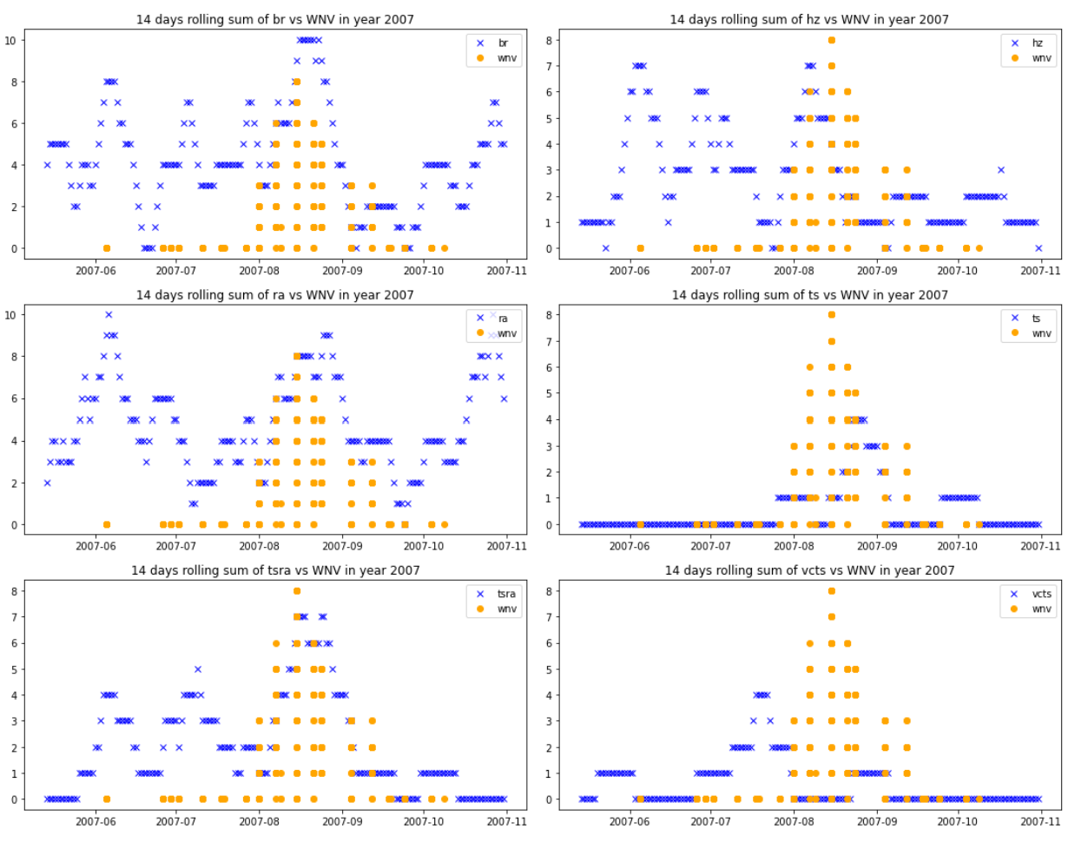
EDA: Weather Conditions
Weather conditions with highest correlation to WNV:
Thunderstorm
Thunderstorm / rain
Vicinity thunderstorm
Rain
Mist
Haze

Slide 19
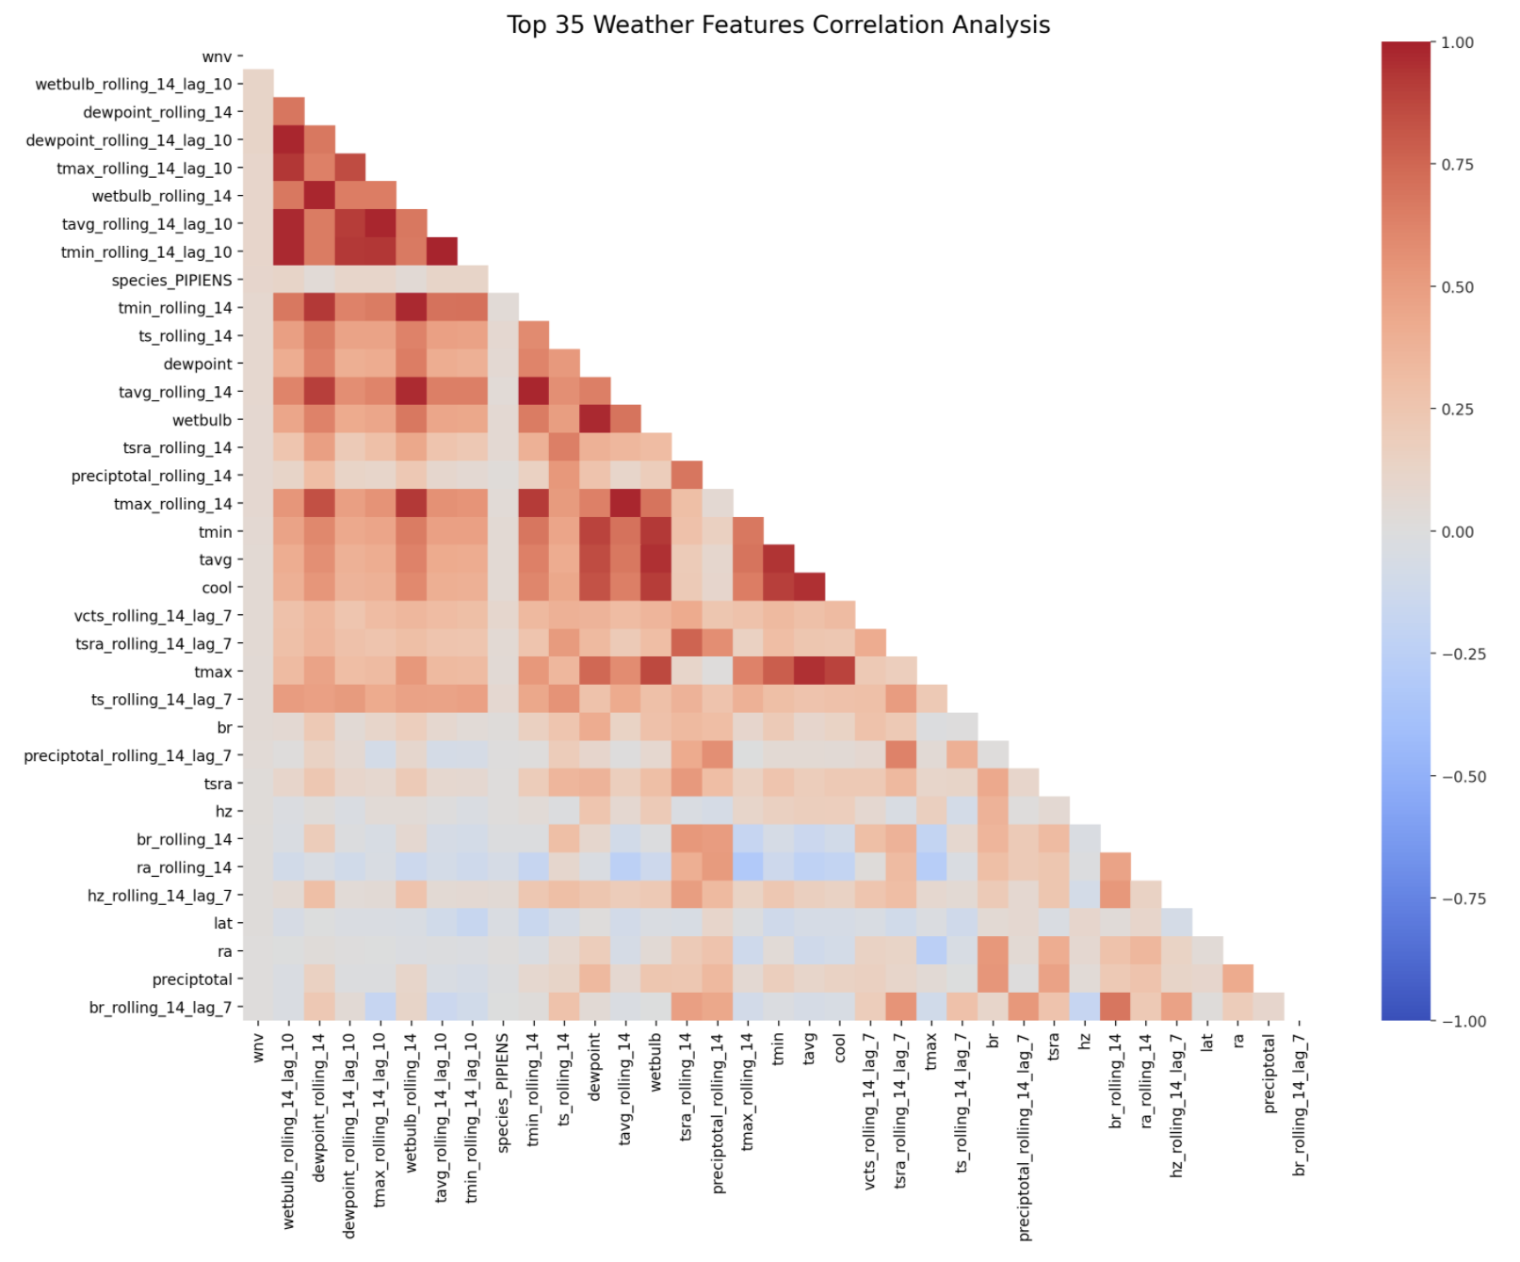
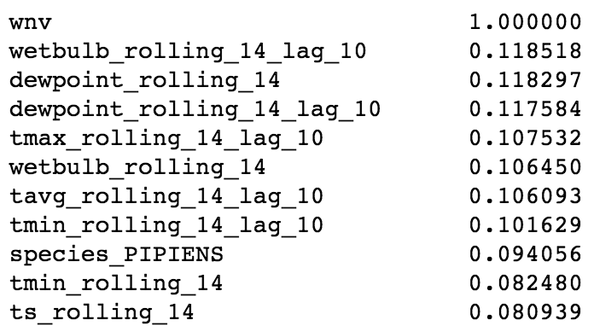
EDA: Top Features
Temperature-related features most correlated with one another
Rolling average and time lags increase correlation between weather features and WNV

Slide 20
Modelling
Models Tested:
Logistic Regression
K-Nearest Neighbors
Random Forest
Extra Trees
Support Vector Machine
XGBoost
Grid Search with Pipeline:
1) standard scaler
2) resampling with SMOTE
3) classifier

Slide 21
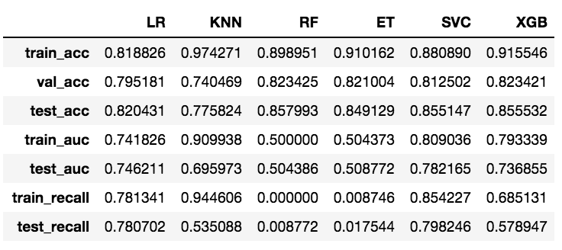
Modelling Results
Optimize for ROC AUC and Recall

Slide 22
Kaggle Submission Score
Using SVC with SMOTE, our best parameters are:
'sampling__sampling_strategy': 'auto',
'svc__C': 0.2,
'svc__degree': 3,
'svc__kernel': 'poly'
Kaggle Set
Kaggle Score: 0.683

Slide 23
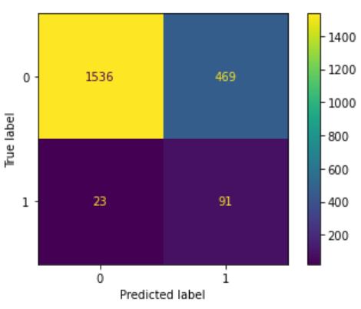
Final Model:
Support Vector Machine
Drawback:
polynomial kernel does not produce coefficients
Rely on second best model for examine features
confusion matrix for SVC

Slide 24
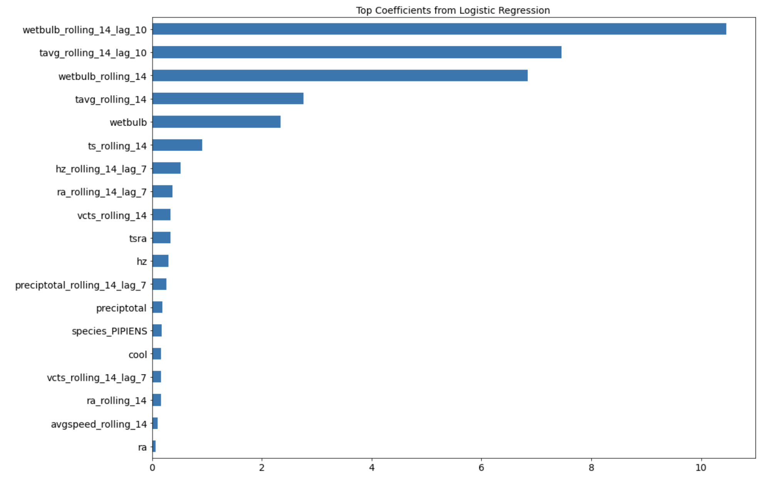

Slide 25
Cost Benefit Analysis
Estimated Epidemic Cost:
Nationwide: $778 million over 15 years
Louisiana (2005): $20 million
Sacramento, California (2005): $2.98 million
Average cost per infected person: $18,000 - $61,000 (depending on severity)
Cost of spraying:
Vector Control Cost: $701, 790
15 prevented WNV cases would justify the cost
Notes:
According to research

Slide 26
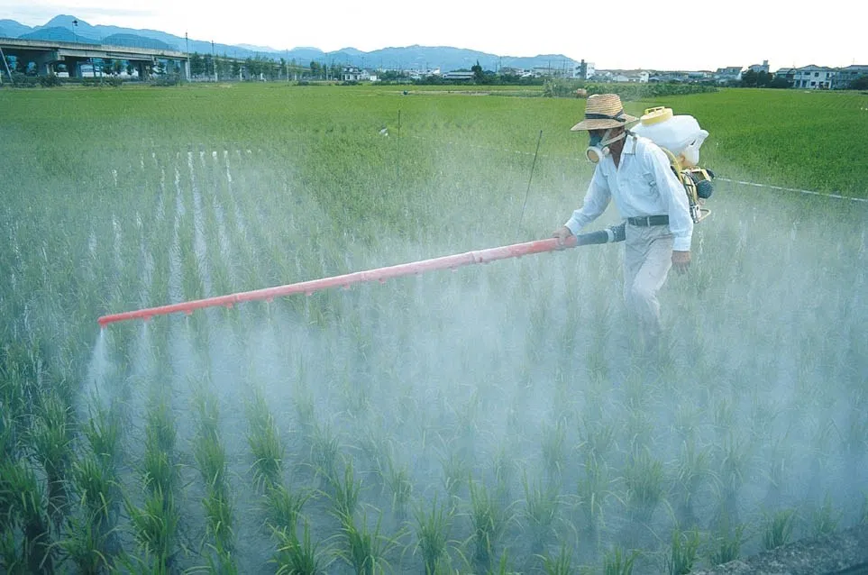
But is this enough?
Notes:
According to research

Slide 27
Cost Benefit Analysis
Optimise spraying for weather conditions and months:
Lower wind speeds (reduces spray drift)
Temperatures below 86°F (30°C)
Humidity above 45%
July to September
Notes:
According to research

Slide 28
Cost Benefit Analysis
Alternative Measures
Eliminate mosquito breeding grounds
Insect repellent
Long-sleeve shirts and long pants
Notes:
According to research

Slide 29
Conclusion / Recommendations
Pesticide spraying is not enough
Combination of spraying and alternative measures
Spray in the right weather conditions
Get data on number of WNV cases reported for better prediction

Slide 30
THANK YOU

